Slide 1


Green Pace
Security Policy Presentation
Developer: Daniel Anderson
Notes:
Green pace presentation

Slide 2

OVERVIEW: DEFENSE IN DEPTH
Security not only protects your company but also protects your clients and thus should be at the forefront of any development.
Notes:
Discuss the importance of DiD and why all companies should have this as their focus not only in application development but also within employee knowledge to protect the company on all fronts.

Slide 3
THREATS MATRIX
Likely Memory Protection, Object Oriented Programming. | Priority Data Type, Namespace.
Low priority Headers. | Unlikely Data Value, String Correctness, SQL Injection, Assertions, Exceptions,
Notes:
This matrix shows the different ranges of threats that can be dealt with by any company. Going from left to right you can see that the further right that you go the riskier and more dangerous the threat can become. Going from top to the bottom you can see that that likelihood goes down the more down you go on the threat matrix. What this shows is that any threat in the very upper right are very likely and also very dangerous and in the lower left is very unlikely and not very dangerous in comparison to what is out there.

Slide 4
10 PRINCIPLES
Validate Input Data
Heed Complier Warnings
Architect and Design for Security Policies
Keep It Simple
Default Deny
Adhere to the Principle of Least Privileged
Sanitize Data Sent to Other Systems
Practice Defense in Depth(DiD)
Use Effective Quality Assurance Techniques
Adopt a Secure Coding Standard

Slide 5
CODING STANDARDS
Rule | Severity | Likelihood | Remediation Cost | Priority | Level
STD-010-CPP | High | Likely | Medium | P18 | L1
STD-005-CPP | High | Likely | Medium | P18 | L1
STD-003-CPP | High | Likely | Medium | P18 | L1
STD-006-CPP | Medium | Probable | Medium | P8 | L2
STD-004-CPP | High | Probable | High | P6 | L2
STD-002-CPP | High | Unlikely | Medium | P6 | L2
STD-001-CPP | Medium | Likely | Medium | P4 | L3
STD-009-CPP | Medium | Probable | High | P4 | L3
STD-008-CPP | Medium | Unlikely | Medium | P4 | L3
STD-007-CPP | Low | Probable | Medium | P4 | L3

Slide 6
ENCRYPTION POLICIES
Encryption Type | Policy
Encryption in Rest | Encryption for data at rest is the process of securely encoding data as it is written into storage and decrypting that data as it is pulled from storage for use
Encryption in flight | Encryption of data in - flight is the process of securely encoding data as it is being transmitted in some fashion.
Encryption in use | Encryption of data in - use is the process of protecting data as it is utilized in memory

Slide 7
TRIPLE-A POLICIES
Triple-A-Framework | Policy
Authentication | The process used to prove who a user is by, userID, passwords, possibly higher-level security such as secure tokens, CAC/PIN and other hardware credentials
Authorization | Once a user is authenticated, and allowed access to a system, they are granted specific access to parts of that system. Authorized access to certain drives, folders, programs, or data allowed by the system administrators.
Accounting | After authentication and authorization, it is always a good idea to monitor and record any transaction or anything that does happen.

Slide 8
Unit Testing
[Identify the coding vulnerability you chose to test. Include four to six mixed tests for positive and negative results. Include a slide for each test. Use the question for the test as the title. Show the results.]

Slide 9
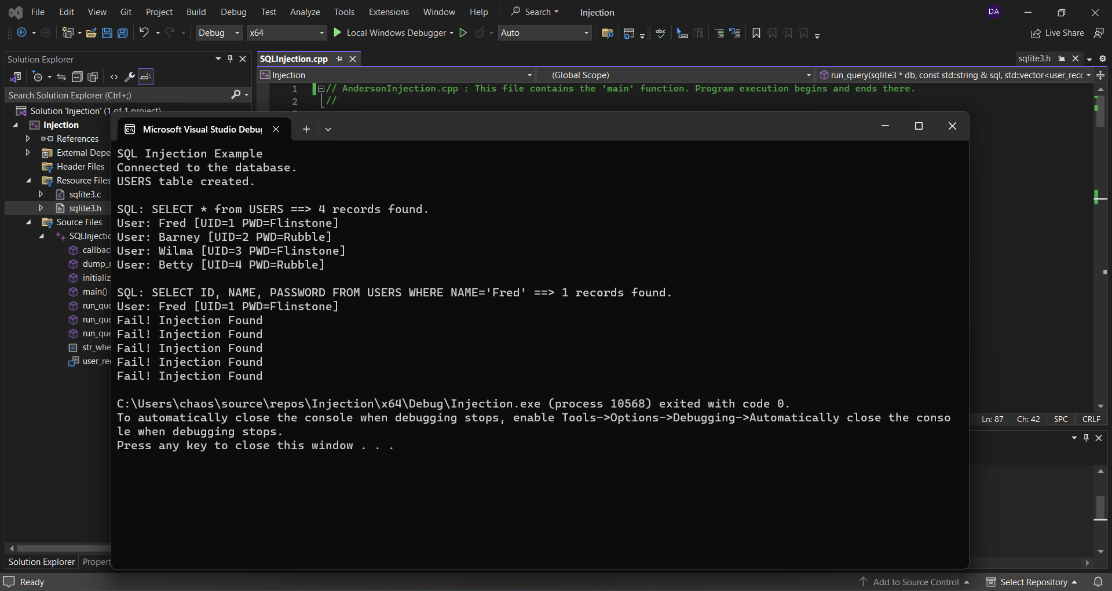
SQL Injection

Slide 10
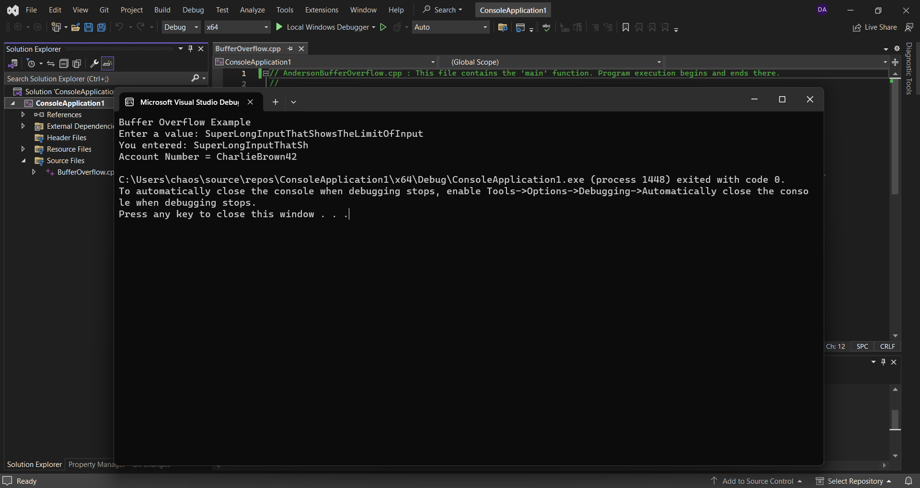
Buffer Overflow

Slide 11
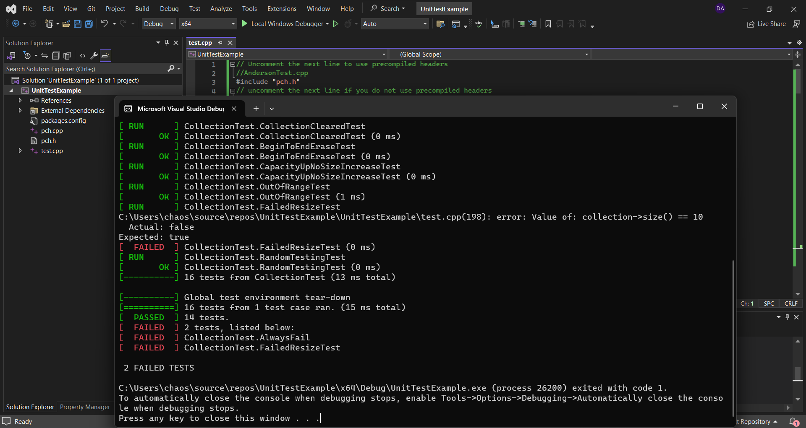
Exceptions

Slide 12
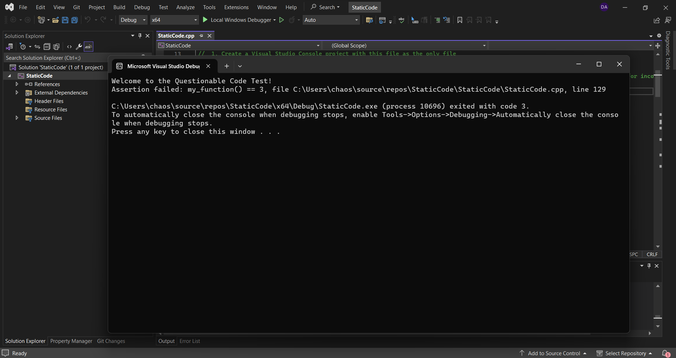
Static Testing

Slide 13

AUTOMATION SUMMARY

Slide 14
TOOLS
DevSecOps is short is putting security first within the Software Development Life Cycle(SDLC).
There are many different external tools that can be used with the SDLC. Two common external tools are Static Application Security Testing (SAST) and Dynamic Application Security Testing (DAST).
SAST is great for automated vulnerability scans for your application while it is being developed. SAST is great to use during all stages of the DevSecOps diagram.
DAST is great for attacking your code from the outside. DAST is better used at the end of the DevSecOps to test the out the full system environment.
Together SAST and DAST should be used to ensure your application has put security second in the development period.

Slide 15
RISKS AND BENEFITS
•Acting now is great because it allows you to implement your security at the beginning and allows you to have it at the forefront of everything you do in application development. The problem with this process is that the development cycle takes longer. The risks involve a longer development time which could increase the cost of the development cycle.
•Waiting to act is great for reducing the development time of your application. The reduction in the development cycle time can reduce the cost of the development. The biggest issue is that problems are not known until the problems have been exploited and could cause many more issues. Waiting to act is very problematic because it can cause massive amounts of damage to the company.

Slide 16
RECOMMENDATIONS
SAST and DAST should in implemented at the beginning of DevSecOps
Testing constantly should be implemented.
Doing the correct tests for your application should be completed.
Constantly review and maintain the coding standards and principles.
Outside involvement to help test is a great way to get outside testing.

Slide 17
CONCLUSIONS
Overall maintain coding standards and policies should always be upheld through out the entire development cycle.
Security should always be at the forefront of all development.
Constant revision of application should be done
Keeping software up to date should always be maintained.
Random testing after completion should always happen at random times.

Slide 18
REFERENCES
Schela, R. (2023, September 05). SEI CERT C++ Coding Standard. Confluence. https://wiki.sei.cmu.edu/confluence/pages/viewpage.action?pageId=88046682
Foster, S. (2021, January 22). DevSecOps Pipeline Overview: DevSecOps Simplified. Perforce. https://www.perforce.com/blog/kw/devsecops-pipeline-overview

